Slide 1

Anime Rank Prediction
On Myanimelist.net

Slide 2
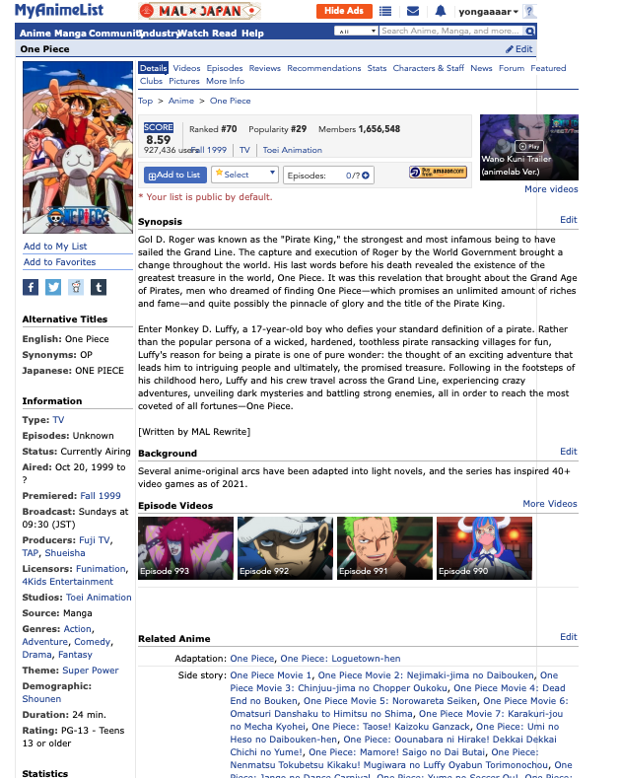


INTRODUCTION
Target:
Rank
Features:
Type | Episodes | Members| Favorites| Genre| Studio |Rating | Demographic | Theme| Popularity | Source | Rank
Notes:
Features important to predict rank cus why is one piece rank at 70th does not make sense. Also in a general sense understand why which animes do so well

Slide 3

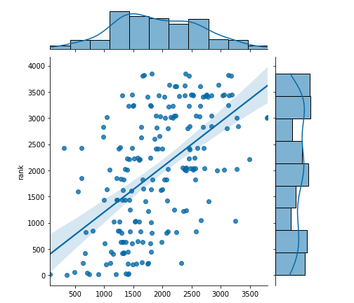
Initial dataset | 219 Features
Post Feature engineering | 70 Features
K-Best Selection | 50 Features
Baseline Prediction:
Train R2:0.43
Val R2: 0.28
MAE: 815.64

Slide 4
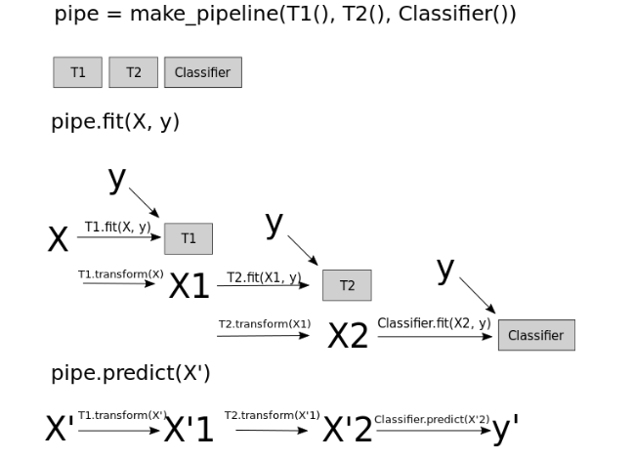

Polynomial Degree: 2
Scaler: Standard Scaler
Lasso Alpha: 50

Slide 5
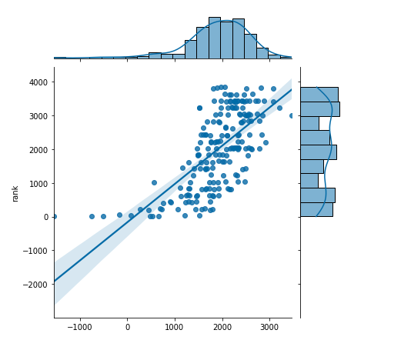
Pipe Prediction:
Pipeline
Train R2: 0.55
Validation R2:0.45
MAE: 659.40
Baseline
Train R2:0.43
Validation R2: 0.28
MAE: 815.64

Slide 6
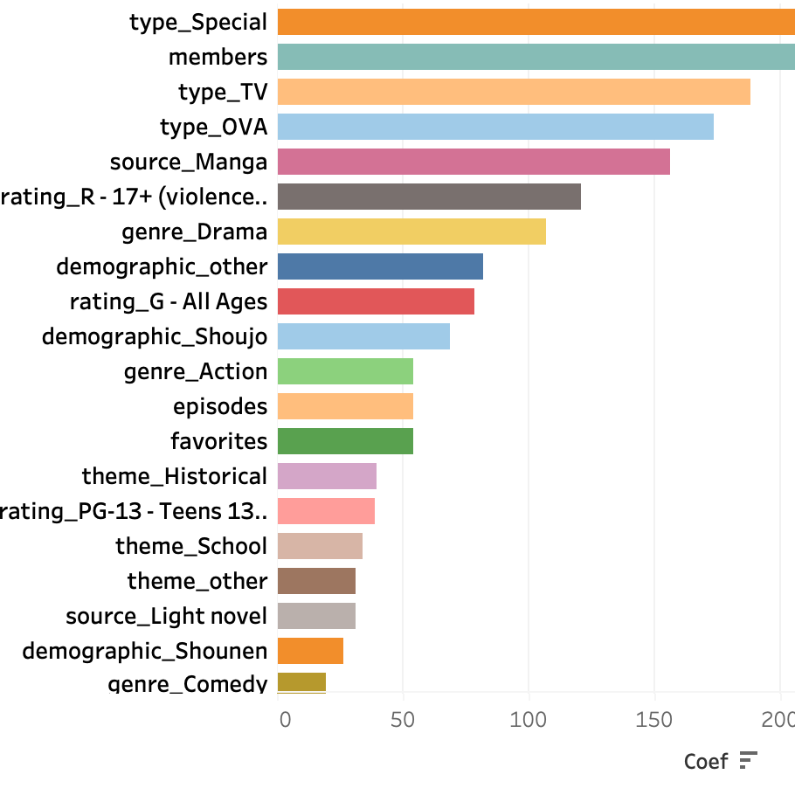


Slide 7
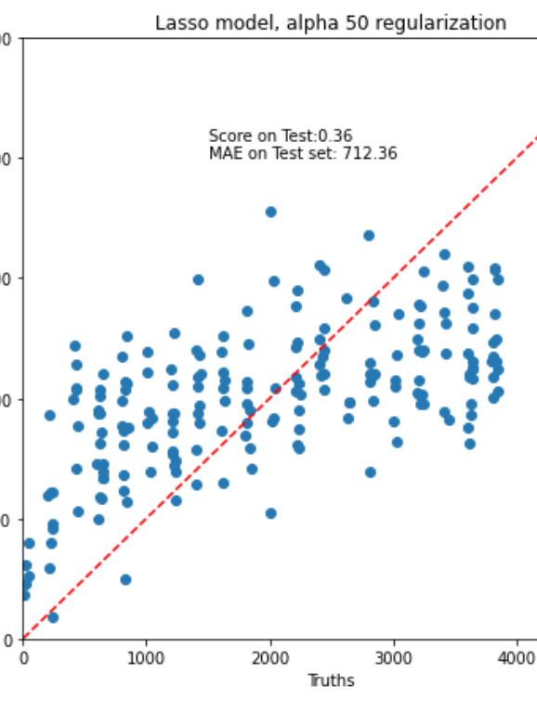
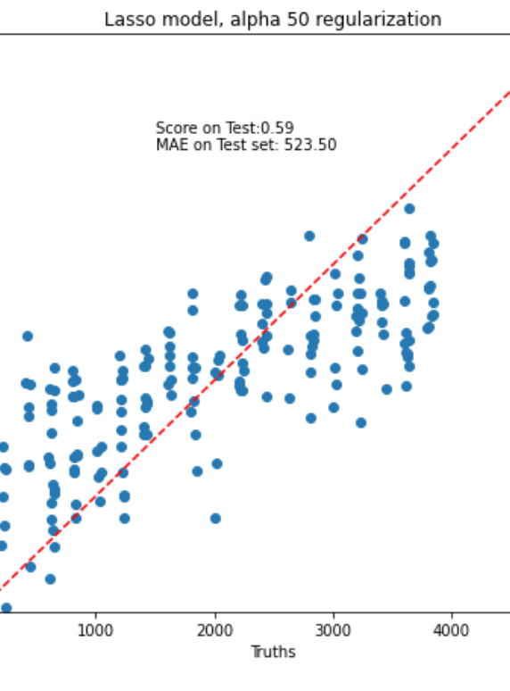
Pipe.predict(X_test)
Random Forrest classifier to compute feature importance, pipe.predict()

Slide 8

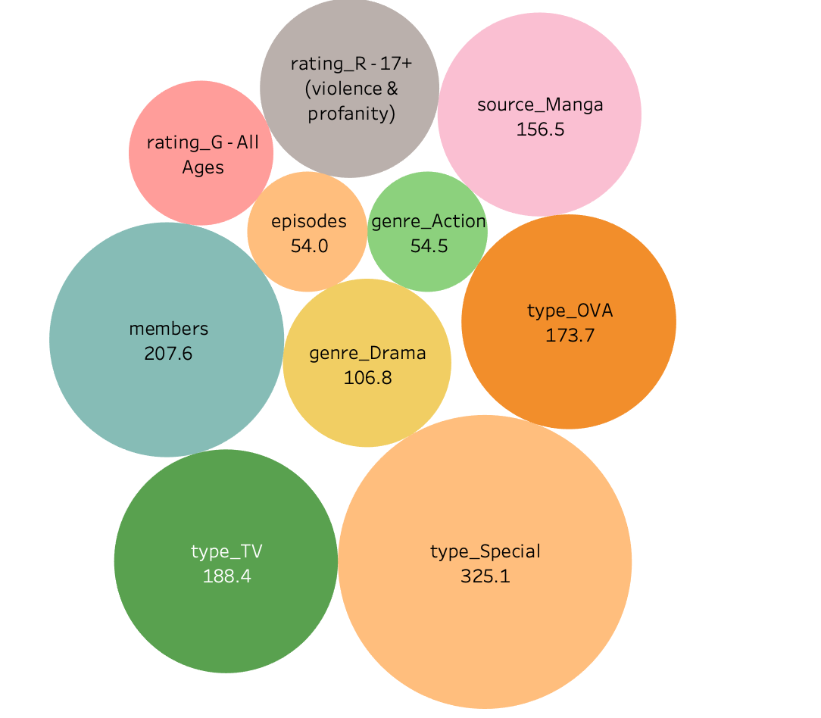
Key Features:

Slide 9

Future work
Collect more features and data points.
Understand and implement interactions that could enhance model performance.
Investigate and implement a more fitting model .

Slide 10

Thank You! Arigatou!

